Slide 1
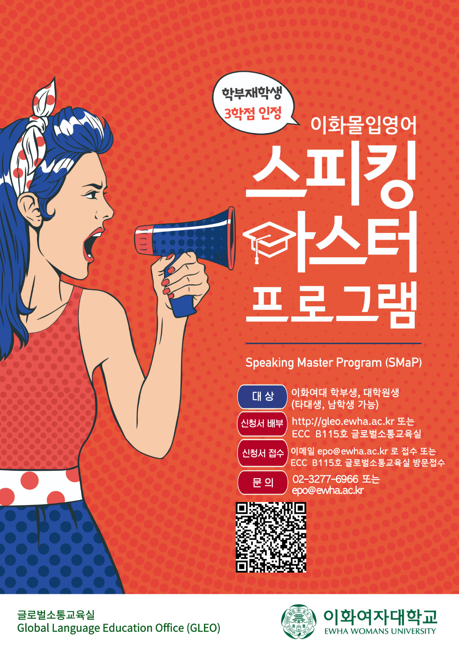
이화여자대학교 글로벌소통교육실

Slide 2
What makes the Speaking Master Program different?
Low cost, highly efficient English Speaking Immersion Program
Exposed to English for 4 weeks, 4 hours daily – all activities and classes proceeded in English
All classes proceeded in small numbers,
4 different classes and activities every day.

Slide 3
What makes the Speaking Master Program different?
Learn from the masters - faculty with masters or Ph.D. degree specializing in TESOL or English.
Become a speaking master - develop confidence for your future (jobs, study abroad, English lectures, etc.)
Get 3 credits through registering for “Practical English” (Exchange credits also available for other university students) No grades, just Pass/ Fail.

Slide 4
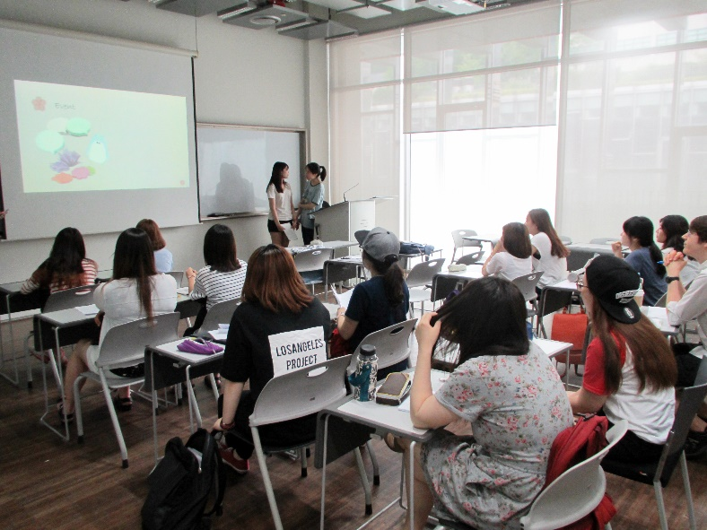
1st Period: Skill-Based Class
1:00~1:50
Classes tailored to different levels
Improve natural communication skills
Develop advanced speaking skills
through discussion, presentation, etc.
Discussion
Presentation
Public Speaking

Slide 5
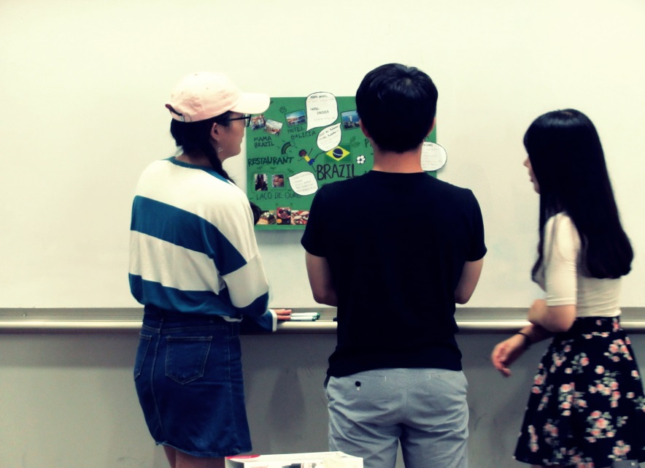
2nd Period: Theme-Intensive Class
2:00~2:50
Theme-Intensive classes – immersed in the interesting classes, you’ll suddenly discover that you are thinking and communicating in English
Cinema and Discussion
English in Action
Debate
The Music Experience

Slide 6
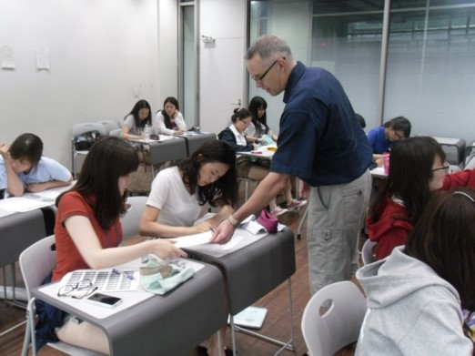
3rd Period: Situation-Intensive Class
3:00~3:50
Build confidence and strengthen your ability to help you study abroad, apply for jobs, or succeed in future English courses
Job English
Current Issues
Travel and Culture
Psychology for Discussion

Slide 7
2nd Period: Theme-Intensive Class
2:00~2:50
Theme-Intensive classes – immersed in the interesting classes, you’ll suddenly discover that you are thinking and communicating in English
Language Games
Cinema and Discussion
Debate
Pillars of Pop Music

Slide 8
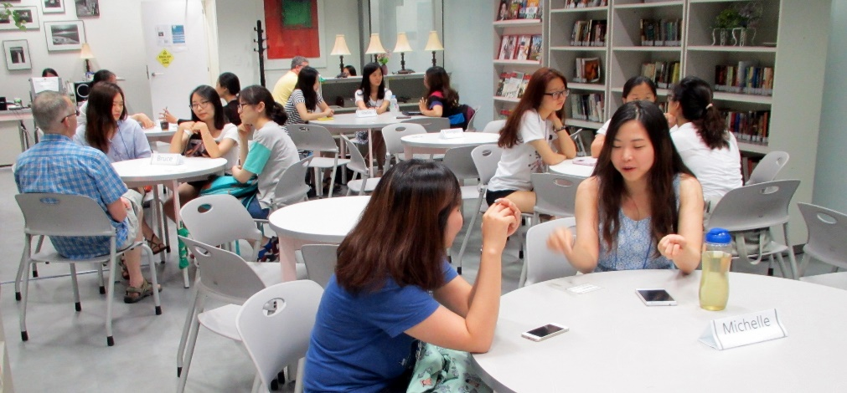
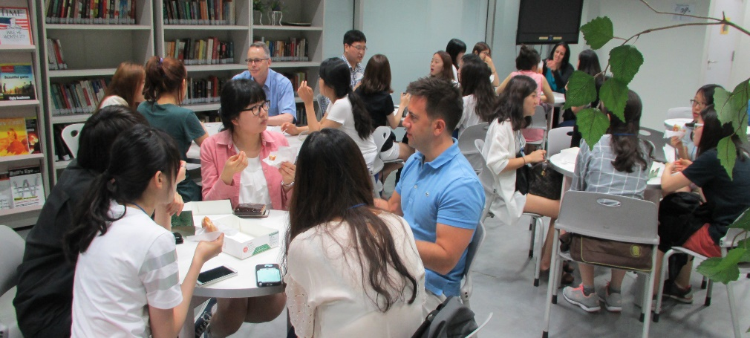
Speaking Tutoring with Tutors
4:00~4:55
Small group discussion daily for fluency and confidence

Slide 9
◉ For College and Graduate School Students
(Male students and
students from other universities welcome)
◉ Contact
http://gleo.ewha.ac.kr
Tel) 02-3277-6966
E-mail) epo@ewha.ac.kr

